Slide 1
Development of a Prototype Underwater Test Platform for the Low Reynolds Number Regime
Cody J. Karcher and Derek A. Paley, Ph.D.
University of Maryland, College Park
Presented at the
American Institute of Aeronautics and Astronautics
Region I Student Conference, April 25, 2014

Slide 2
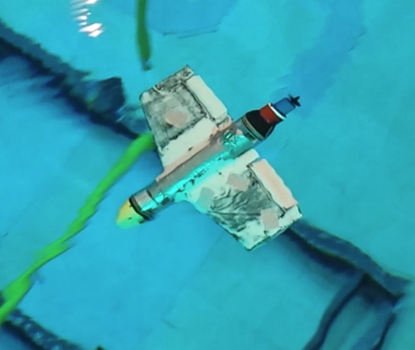
Overview
Motivation
History
Design
Simulation
Construction
Testing
Contributions
Future Work

Slide 3
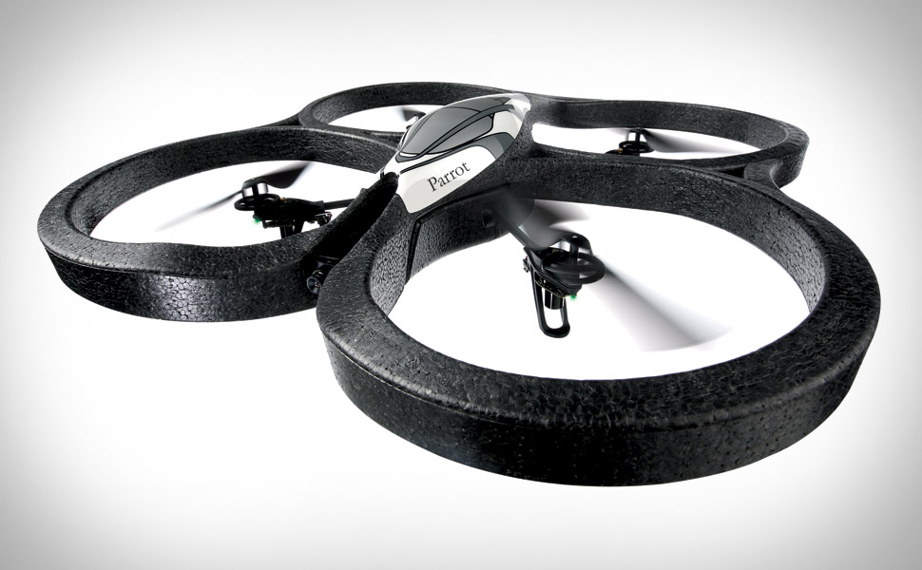
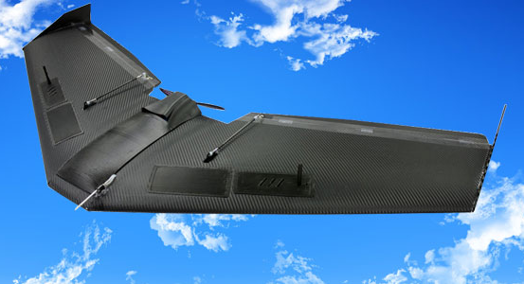
Motivation
Increasing interest in MAV’s
Private and Military
University of Maryland’s strong history with MAV’s
Cyclocopters, Bio-Inspired Design

Slide 4
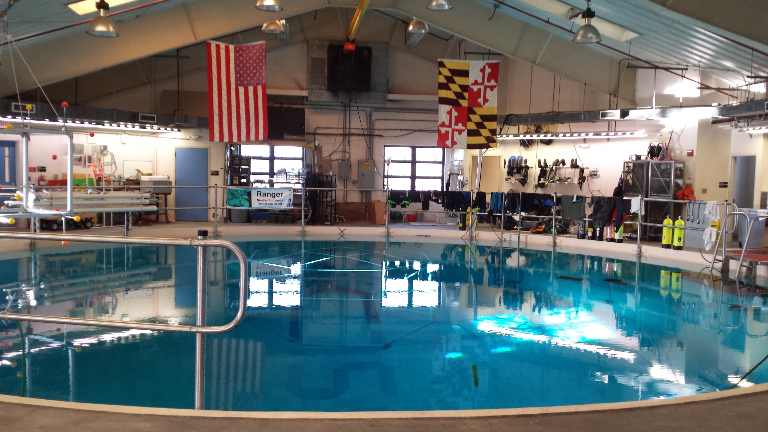
The CDCL
Dedicated to studying behavior of groups of vehicles
Experience with MAV’s
Underwater motion capture facility
Experience in the low Reynolds number environment

Slide 5
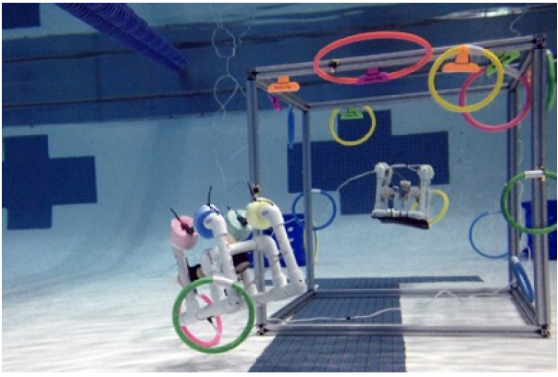
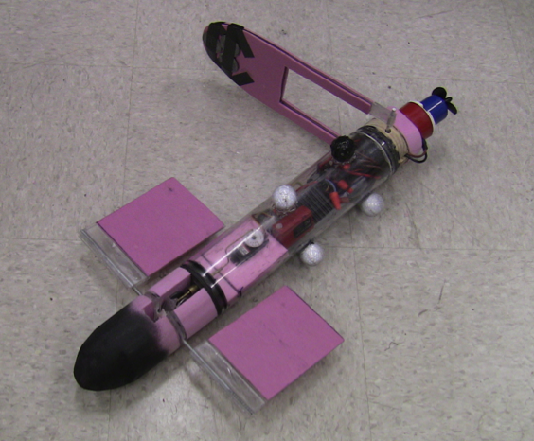
History
Sea Perch
3 axis motor control
Poseidon
Single motor
Two Control Inputs

Slide 6
Design: Mission
Match Reynolds number of an MAV
approximately 50,000
Generate lifting force
Minimum number of control inputs
Wingspan not to exceed 24”
Operational to a depth of 20’

Slide 7

Design: Working Underwater
Electronics
Buoyancy
Pressure
Communication

Slide 8
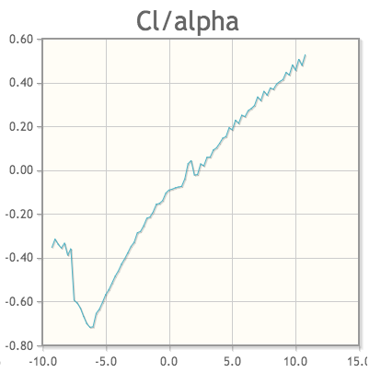
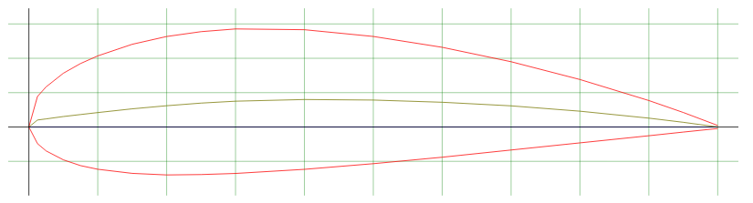
Design: Preliminary Design
Configuration
Reynolds Number Scaling
Airfoil
NACA 4421

Slide 9
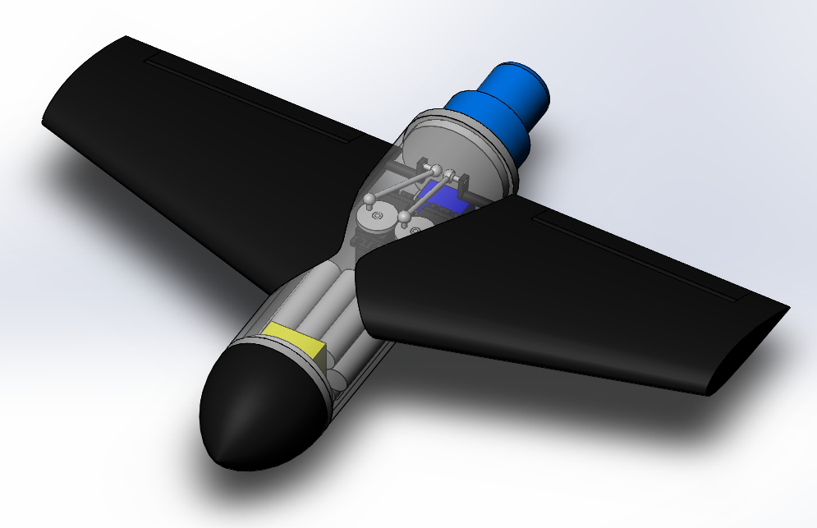
Design: Preliminary Design
Structure
Carbon Sandwich Structure
Propulsion
Bilge Pump
Control
Battery
CAD Modeling

Slide 10
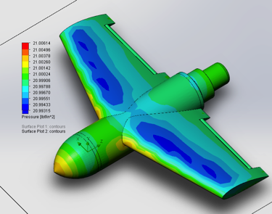
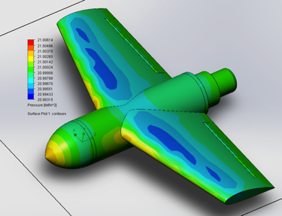
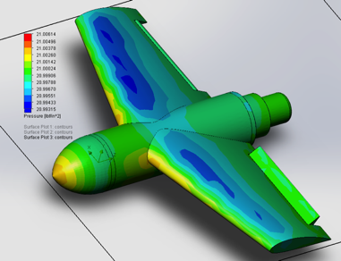
Simulation
Run in SolidWorks Flow Simulation Package
Results in line with expectations

Slide 11
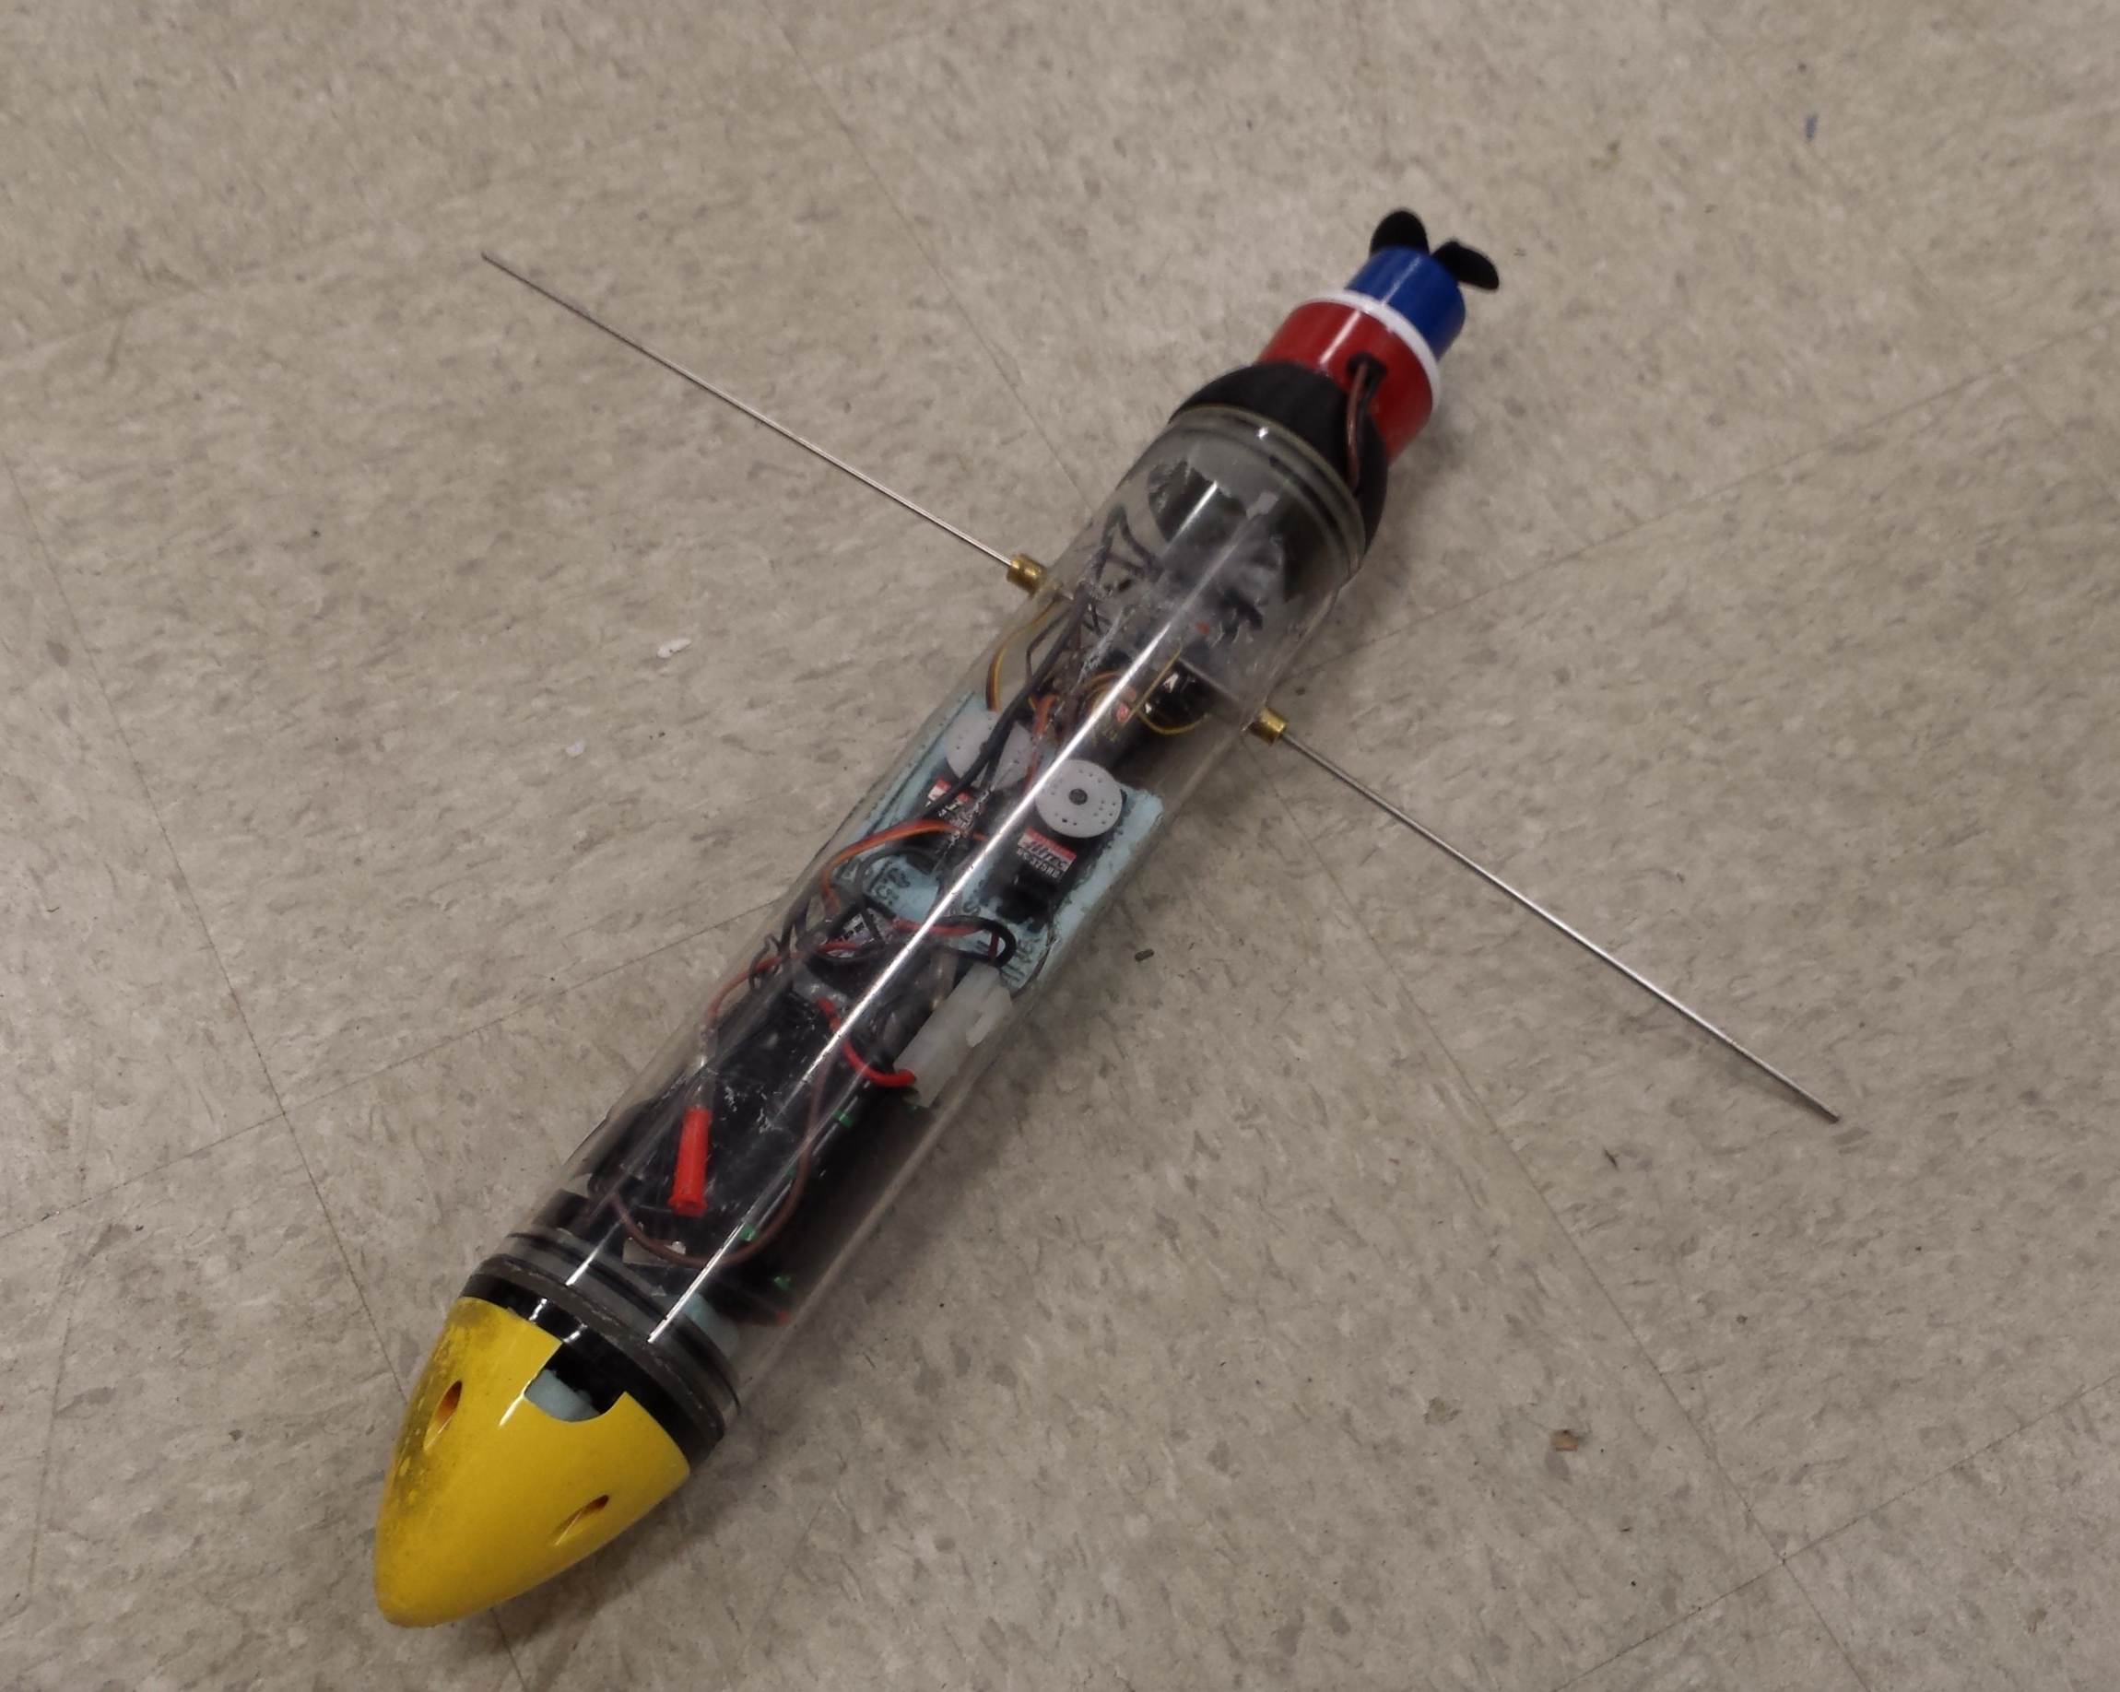
Construction: Pressure Vessel
Holes and pressure seals
Servomotors
Battery
Assembly

Slide 12
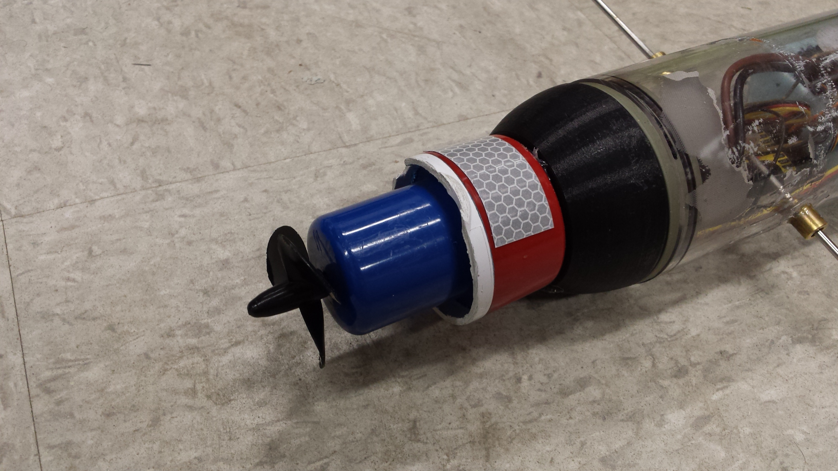
Construction: Thruster
Modified bilge pump
Housing removed
Impeller removed
Hobby boating propeller added

Slide 13
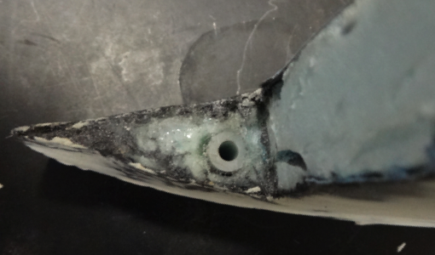
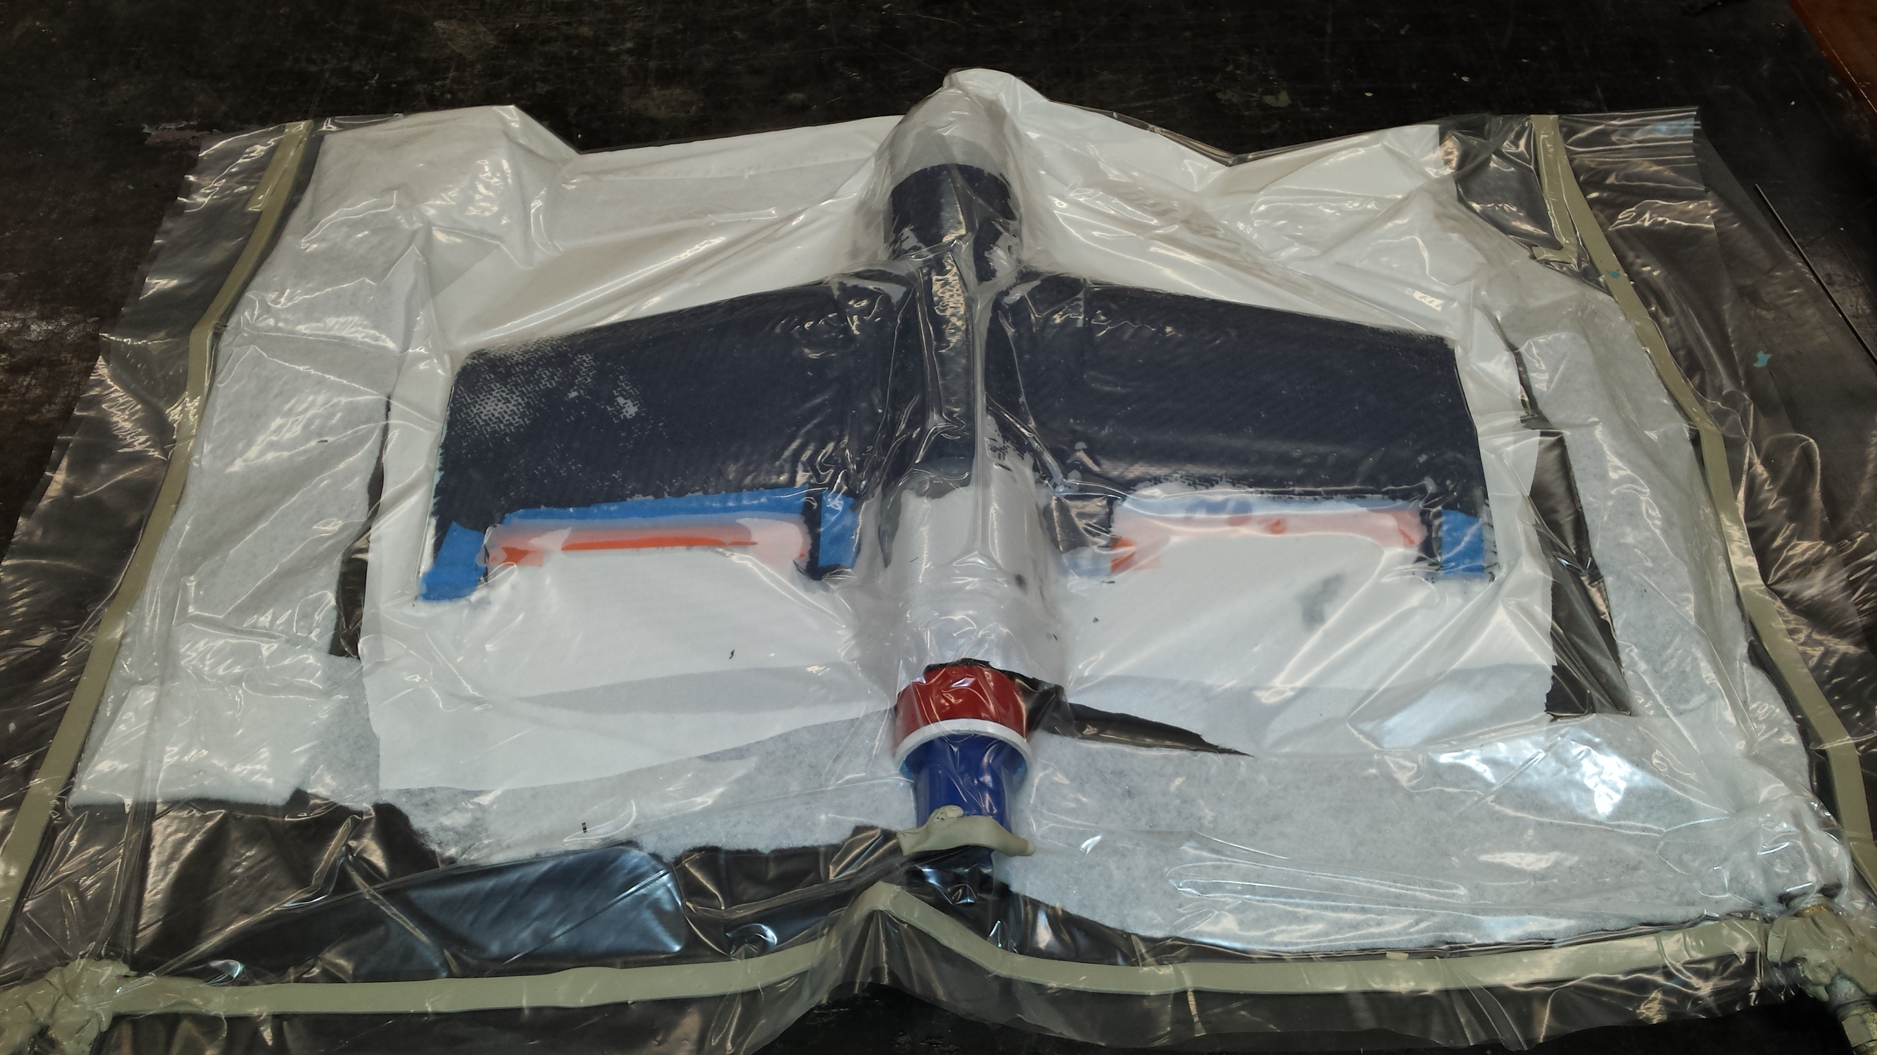
Construction: Wings
Foam cores cut
Trailing edge pivots
Composite structure
Vacuum bag

Slide 14
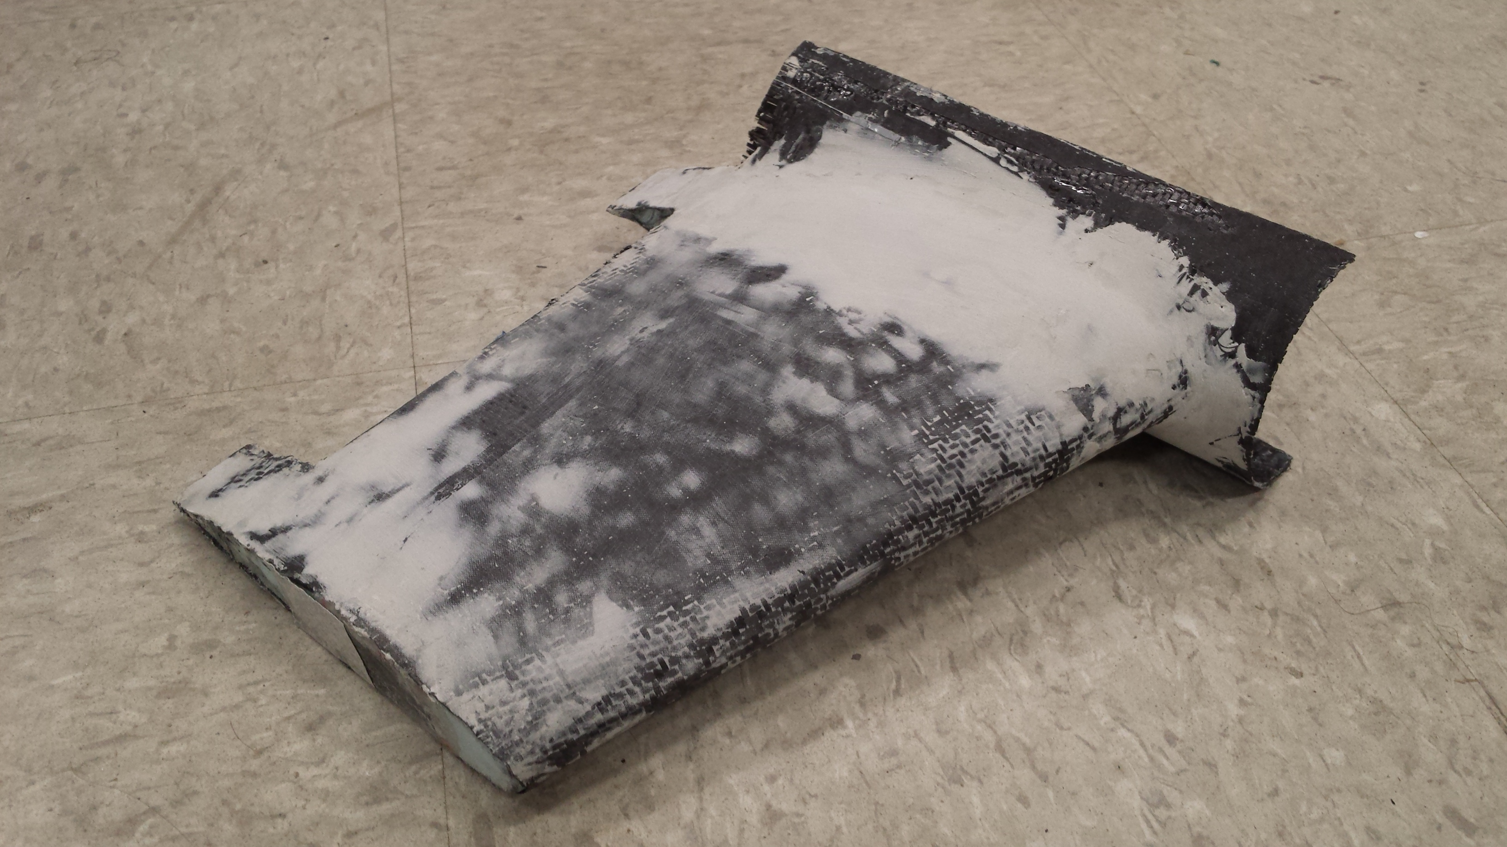
Construction: Wings
Composite Touch Ups
Trailing Edge
Bondo Smoothing
Laminar Flow

Slide 15
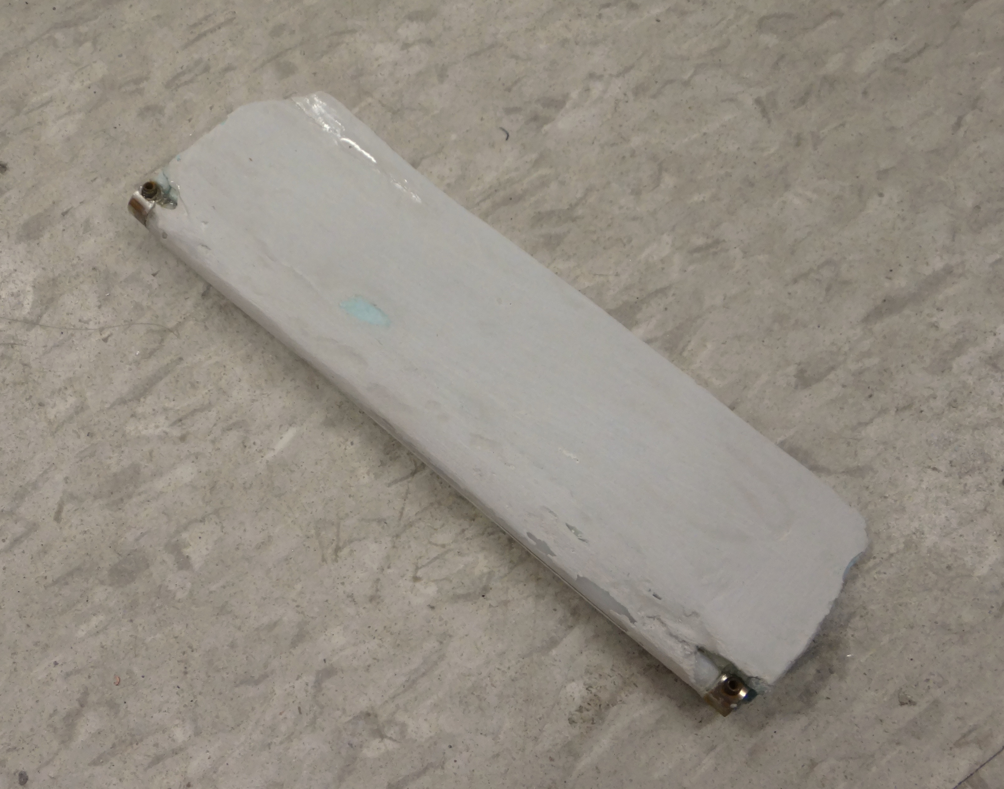
Construction: Elevons
Cut from wings
Delrin tube attachment
Shaft collars

Slide 16
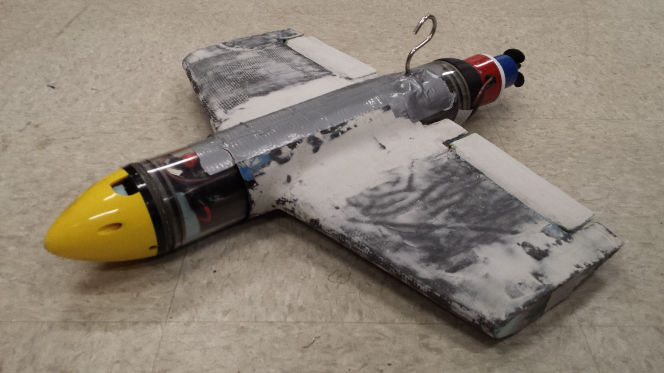
Construction: Assembly
Wing orientation
Salvage hook

Slide 17
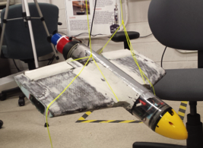
Testing: Moment of Inertia
Desired for Flight Testing
Bifilar Pendulum
Mohr’s Circle for moment of inertias
2Φ
I_{xz}
I_{xx}
I_{zz}
Principal Axes
Geometric Axes

Slide 18
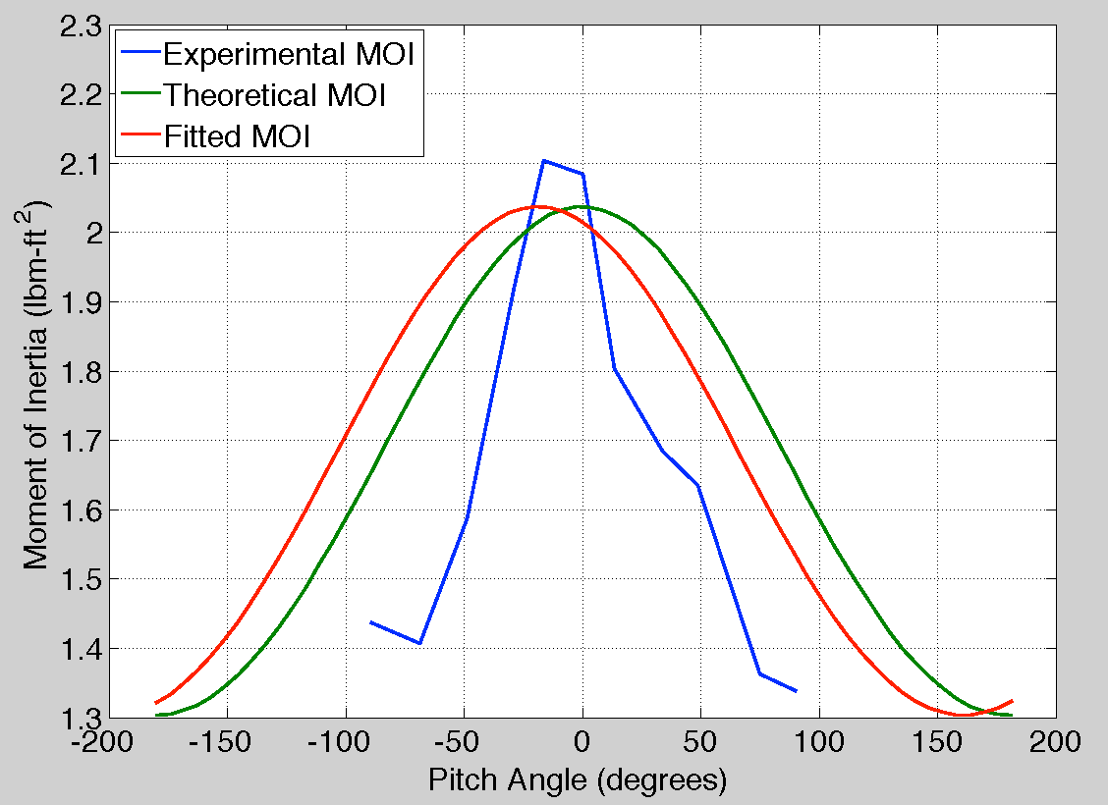
Testing: Moment of Inertia
I_{xx}: 1.3814 lbm-ft²
I_{yy}: 0.8213 lbm-ft²
I_{zz}: 1.9598 lbm-ft²
I_{xz}: 0.2251 lbm-ft²

Slide 19
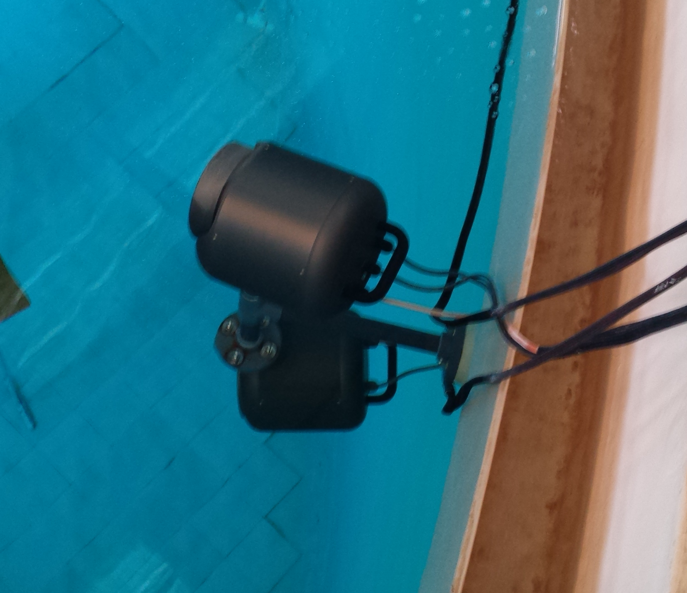
Testing: Flight Testing
Connectivity troubles
Transmitter: 500 mW, 27 dB
Loss at 60° and 5’ depth: ≈22 dB
CG Location
Handling Qualities
Directional Stability

Slide 20
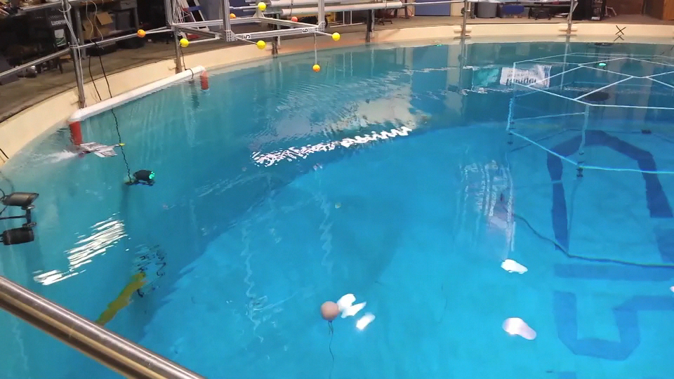
Testing: Flight Testing

Slide 21
Contributions of the Research
Bridge two research realms
Flow visualization
Low Reynolds number aerodynamics
Underwater platform for aeronautics

Slide 22
Future Work
Short Term
Build stability and control matrices at various flight conditions
Improve connectivity in the test facility
Possible Long Term Extensions
Demonstrate stability in gust response
Improve durability and construction methods

Slide 23
References: Citations
Davis, W. R. Jr., Kosicki, B. B., Boroson, D. M., and Kostishack D. F. “Micro Air Vehicles for Optical Surveillance,” The Lincoln Laboratory Journal, Vol. 9, No. 2, 1996, pp. 197-214.
Anderson, J. D., Fundamentals of Aerodynamics, 5th ed., New York, 2007, Chap. 1.
Mattey, R. A., “Bifilar Pendulum Technique for Determining Mass Properties of Discos Packages,” Naval Plant Representative Office, Rept. TG 1252, John Hopkins University, Applied Physics Laboratory, MD, July 1974.
Bounds, R., “Space Perch: A Human-Robot Interaction Testbed for Communication-Constrained Environments,” AIAA Region I Conference 2014, (submitted for Publication)
Jiang, S., and Georgakopoulos S., “Electromagnetic Wave Propagation into Fresh Water,” Journal of Electromagnetic Analysis and Application, No. 3, 2011, pp. 261-266.

Slide 24
References: Images
http://uncrate.com/stuff/parrot-ardrone/
http://uavcommunity.com/
http://www.seaperch.org/photos
http://www.ubadiving.com/
http://airfoiltools.com/airfoil/details?airfoil=naca4421-il

Slide 25
Questions?
Thanks to:
Professor Derek Paley
Dr. Derrick Yeo
Levi DeVries
Frank Lagor
Raymond Bounds
The Collective Dynamics and Control Laboratory

